Slide 1
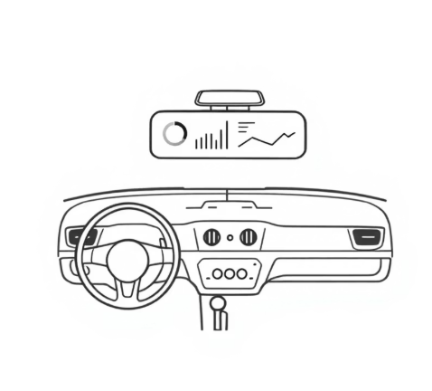
Cab Booking System Analytics Dashboard
Comprehensive data insights for strategic decision-making in cab operations, covering customer behavior, driver performance, revenue trends, and operational efficiency metrics.
Notes:
1

Slide 2

Executive Overview
REVENUE GROWTH
₹380 to ₹17,590 monthly progression demonstrates strong market expansion and customer adoption.
CUSTOMER INSIGHTS
50 total bookings with key loyalty patterns and retention challenges identified across user segments.
OPERATIONAL EFFICIENCY
Distance-based pricing shows 84.54% revenue from long-distance trips, indicating premium service focus.
Notes:
2

Slide 3
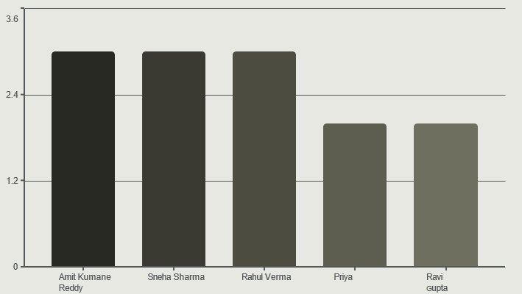
Customer Performance Analysis
Key Customer Insights
Top performers show consistent booking patterns, while Saturday emerges as our busiest day with 12 total bookings.
Priya Reddy presents a 60% cancellation rate despite being a frequent user, indicating service quality concerns.
Notes:
3

Slide 4
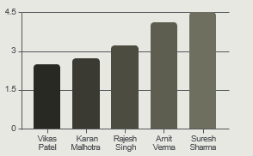

Driver Performance Dashboard
Rating Concerns
Distance Champions
Reliability Issues
Vikas Patel: 2.50 rating
Suresh Sharma: 98km trip
Rohit Rao: 100% cancellation
Karan Malhotra: 2.70 rating
Ramesh Kumar: 97km trip
Vikram Singh: 50% cancellation
Require immediate training intervention
Exceptional long-distance performance
Critical operational risk
Low-rated drivers require immediate training intervention to maintain service standards.
Notes:
4

Slide 5
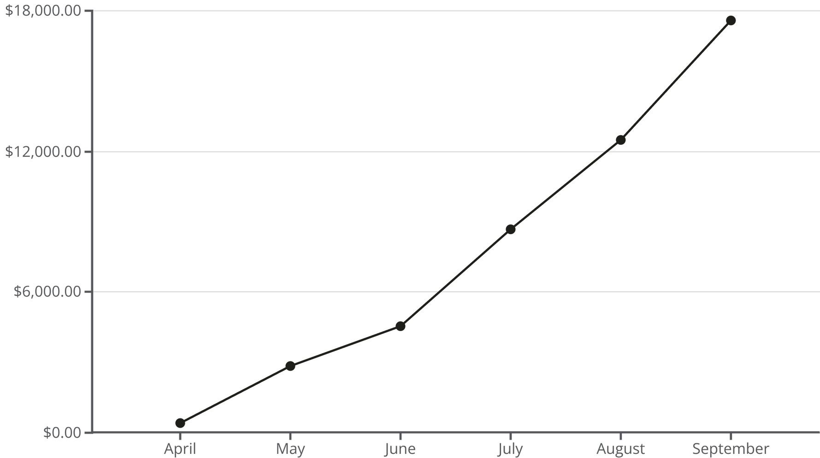
Monthly Revenue Growth Trajectory
Revenue demonstrates growth from April to September, indicating successful market penetration and operational scaling. September alone generated ₹17,590, representing our strongest monthly performance.
Notes:
5

Slide 6


High-Traffic Route Analysis
Connaught Place ↔ Dwarka Sector 10
5 trips each direction - Primary business corridor connecting commercial hub to residential area
Lajpat Nagar → Saket Mall
5 trips - Shopping and entertainment destination driving consistent demand
Airport Connectivity Routes
4 trips average - Premium pricing opportunities for long-distance airport transfers
Notes:
6

Slide 7

Operational Efficiency Metrics
Waiting Time Analysis
Cancellation Breakdown
Chennai: 15 minutes average
Dwarka Sector 10: 12 minutes
Connaught Place: 8 minutes
Nehru Place: 5 minutes (best)
Driver Unavailable
Changed Mind
Cheaper Ride
Took Too Long
Notes:
7

Slide 8
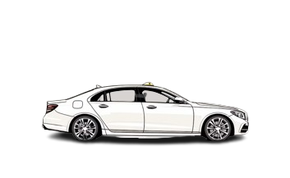

Vehicle Category Performance
SUV Category
Sedan Category
₹9,930 revenue - Premium segment showing strong performance with higher per-trip earnings and customer preference for comfort.
₹9,730 revenue - Competitive performance with SUVs, indicating balanced fleet strategy and diverse customer needs.
Near-equal revenue distribution suggests optimal fleet composition, with SUVs commanding slight premium while sedans maintain volume efficiency.
Notes:
8

Slide 9


Customer Retention Alert
Critical Action Required: Five customers identified as high churn risk based on booking patterns and service interactions.
At-Risk Customers
Rhea Menon
Arjun Pillai
Megha Yadav
Kabir Sinha
Varun Chawla
Retention Strategy
Personalized outreach campaigns
Service quality improvements
Loyalty program enrollment
Feedback collection initiative
Notes:
9

Slide 10

Strategic Recommendations
1
Driver Quality Enhancement
Implement immediate training programs for low-rated drivers and establish performance monitoring systems.
2
Operational Efficiency
Reduce waiting times in Chennai and Dwarka through strategic driver positioning and demand forecasting.
3
Customer Retention
Launch targeted retention campaigns for at-risk customers and address service quality concerns proactively.
4
Revenue Optimization
Capitalize on long-distance trip dominance (84% revenue share) and expand premium SUV offerings.
Notes:
10

